Slide 1
Assignment 2 Progress Report
Gr. King

Slide 2
Introduction

Slide 3
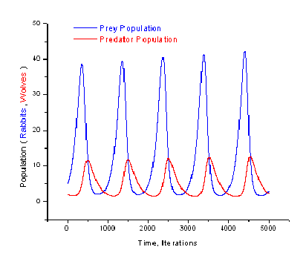
What is a Lotka-Volterra model?
Used to describe evolution in N discrete dynamic variables (Malcai et al., 2002)
2 populations – predator & prey
Ecological Dynamics between populations
Goal – reach stable coexistence (reflected by graphs)
Notes:
AMLA

Slide 4
Problem Description
Develop a Lotka-Volterra model with the following characteristics:
Prey = rabbits (green), predator = foxes (red)
Correct implementation of basic functionality and formulae (documented via graphs)
Optimization of parameters for a correct base implementation
Extension of implementation with extra features (considering flocking) – energy: death probability increases with time
Compare energy-free implementation performance to energy model
Notes:
AMLA

Slide 5
Purpose of Simulation
Gain deeper understanding of the model itself
Explore the behavior of the implementation under different scenarios:
Under different parameters → specifically to aid the goal of optimization
Comparison between versions with added/missing parameters (energy vs. energy-free) → broader goal of observing their relation to performance
Notes:
AMLA

Slide 6
Research Question + Hypotheses
Research Question) Part 1:
To what extent does the concept of energy in predators influence the performance of a Lotka-Volterra Predator-Prey simulation?
Performance measured via graphs (adhering to expectation)
H₀: The concept of energy has no impact on the model’s performance
H_{A}: The concept of energy influences the model’s performance
Notes:
DJIO

Slide 7
Methodology

Slide 8
Agent Modelling:
Energy-free Version
Config:
Initialised fox and rabbit populations,
Δt, rabbit birth rate,
Fox natural death rate, fox predation rate, fox reproduction rate.
Fox class:
Wanders randomly
When in proximity to rabbit, chance to kill
If it does kill, chance to reproduce asexually
If either kill or reproduce fails, return to wandering state
Chance to randomly die due to natural causes
Rabbits class:
Wanders randomly
Chance to reproduce asexually
Notes:
DJIO

Slide 9
Agent Modelling:
Energy Version
Config:
Retains the same parameters as energy-free version
Fox initial energy, energy gained from rabbit, fox reproduction energy cost
Fox class:
Wanders randomly, energy depletes over time.
When in proximity to rabbit, chance to kill
If it does kill, gains energy
If enough energy gained, reproduce
If energy is empty, die.
Chance to randomly die due to natural causes
Rabbits class:
Wanders randomly
Check for reproduction (random no. < birth rate * ∆t)
Every 10 seconds without reproduction, change probability to 50% & try again
Notes:
DJIO

Slide 10
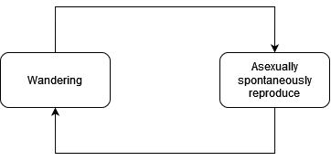
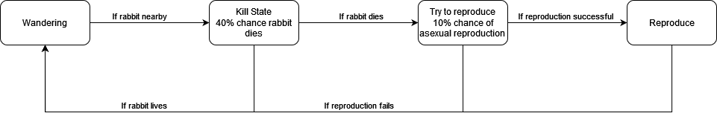
FSM of Rabbit and Fox Behaviour - Energy-Free
Rabbits
Foxes
Notes:
ENEA

Slide 11
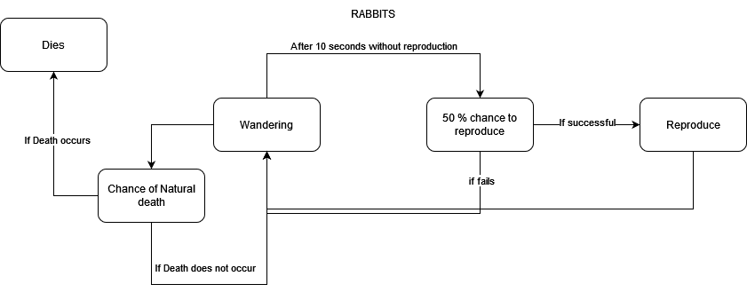
FSM of Rabbit Behaviour - Energy
Foxes
Notes:
ENEA

Slide 12
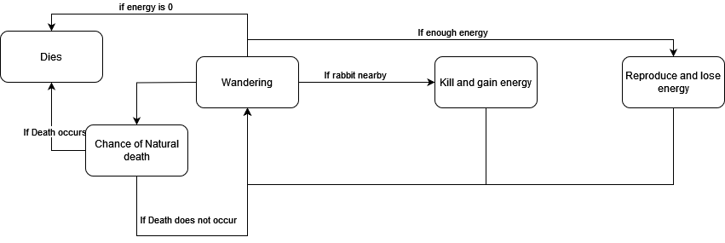
FSM of Fox Behaviour - Energy
Notes:
ENEA

Slide 13
Formulae
The following formulae govern the population sizes of predator and prey under stable coexistence:
Prey population change:
dx/dt = αx - βxy
Predator population change:
dy/dt = -γy + δxy
Where: α = rabbit natural reproduction rate
β = rate of predation
γ = natural death rate of foxes
δ = fox reproduction rate
Not explicitly implemented (since agent behavior coded individually), but used to informally guide implementation
Notes:
ENEA

Slide 14
Results

Slide 15
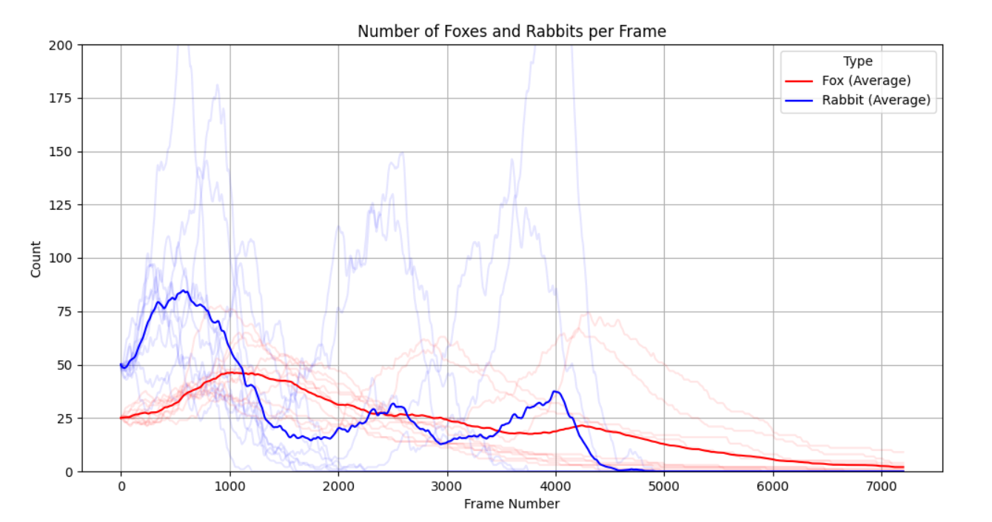
Energy-free
(60 Simulations)
Notes:
LISA

Slide 16
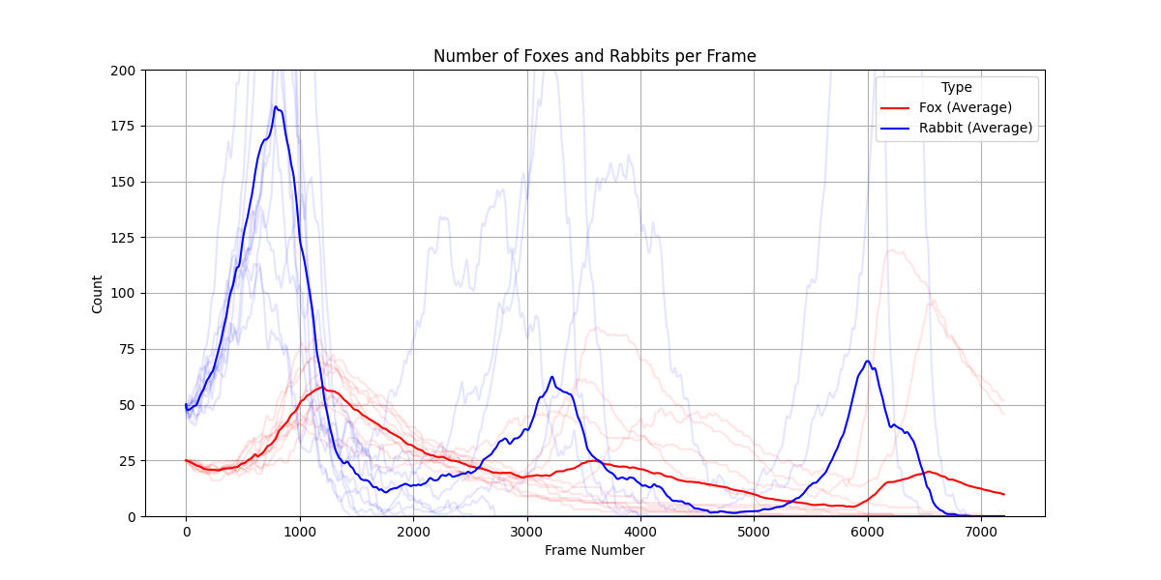
Energy
(60 Simulations)
PLOTS
Notes:
LISA

Slide 17
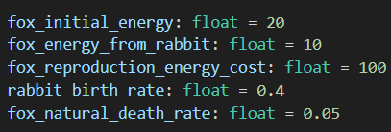
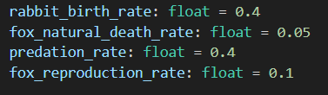
Comparison
Energy
Energy-free
vs
Parameters:
Parameters:
Notes:
LISA

Slide 18
Conclusion

Slide 19
Key Takeaways
Both versions show the prey population following the correct graph path (wave pattern), while the predator population follows a slow decrease
Both graphs depict loss of population → params not yet optimal, no stable coexistence
Energy free → compared to energy version, both prey and predators die out sooner in the energy free version (4500 vs. 7000 frames)
Energy → Amount of foxes and rabbits within the field a lot higher compared to the energy free version. Likely due to the way it is calculated.
Notes:
RICK

Slide 20
Research Question / Hypothesis Follow-up
Research Question) Part 1:
To what extent does the concept of energy in predators influence the performance of a Lotka-Volterra Predator-Prey simulation?
Performance measured via graphs (adhering to expectation) -> Statistical significant testing for further research
H₀: The concept of energy has no impact on the model’s performance
H_{A}: The concept of energy influences the model’s performance
Notes:
RICK

Slide 21
Further Research
Exploration of other possible characteristics/implementations, such as:
Flocking behavior (esp. rabbits)
Energy implementation (grass) for rabbits
Experiment more with the effects of varying parameters (e.g. initial population sizes or birth/death rates)
Notes:
RICK

Slide 22
Further Research (continued)
Further developments for following week:
Advancing research question complexity: Research Question) Part 2: To what extent does flocking behaviour in prey influence the performance of an energy-free Lotka-Volterra Predator-Prey simulation?
Performance measured via graphs (adhering to expectation)
H₀: The concept of flocking has no impact on the model’s performance
H_{A}: The concept of flocking influences the model’s performance
Flocking to be implemented to the current implementation.
Notes:
RICK

Slide 23
References
Lotka-Volterra equations — Scientific Python: a collection of science oriented python examples documentation. (n.d.-d). https://scientific-python.readthedocs.io/en/latest/notebooks_rst/3_Ordinary_Differential_Equations/02_Examples/Lotka_Volterra_model.html
Malcai, O., Biham, O., Richmond, P., & Solomon, S. (2002). Theoretical analysis and simulations of the generalized Lotka-Volterra model. Physical Review. E, Statistical Physics, Plasmas, Fluids, and Related Interdisciplinary Topics, 66(3). https://doi.org/10.1103/physreve.66.031102
Neuhauser, C., & Pacala, S. W. (1999). An explicitly spatial version of the Lotka-Volterra model with interspecific competition. the Annals of Applied Probability/the Annals of Applied Probability, 9(4). https://doi.org/10.1214/aoap/1029962871
Pont, M. T. S., Chamizo, J. M. G., Mora, H. M., & Pascual, J. M. (2013). Resilience modeling by means of a set of recursive functions. https://doi.org/10.1109/dsnw.2013.6615536

